Slide 1

Profit Pilot Data-AI driven auto investing bot

Slide 2




Who and why?
Matias Aravena
Software Developer with over 9 years of experience
Passionate about cycling, aquariums, finances and Investing
Help people Investing
I would like to build something that could create a positive impact.
Investment is overwhelming for rookies.
Accumulate more valuable assets, meaning extra money.
Investment driven by data, not emotions.

Slide 3

Introduction

Slide 4
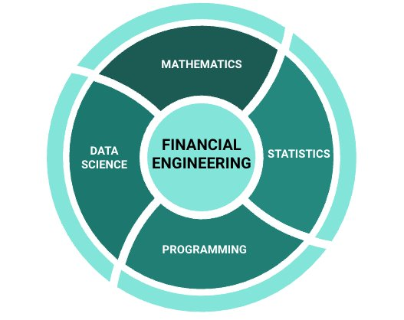
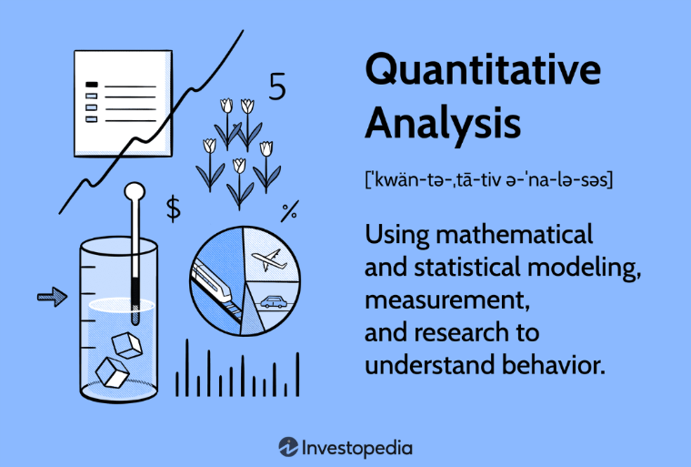
The idea
To whom?
Natural persons that need guidance on how to invest regardless of market timing.
How?
Long term saving that could be used as investment.
Increasing the possibilities of accumulate financial assets
Give hints based on predictions.
Notes:
Utopic project
Long term investing
Accumulate valuable assets
Give hints based on predictions

Slide 5
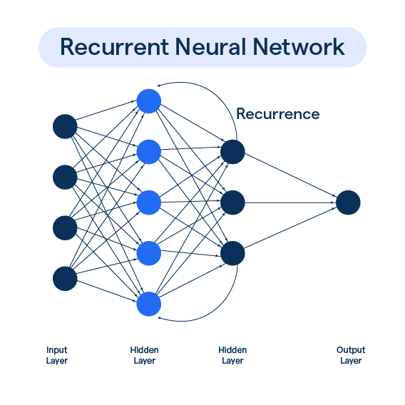
Basic concepts - mL RNN
How does RNN work?
Imagine you want to classify what kind of event is happening at every point in a movie. It’s unclear how a traditional neural network could use its reasoning about previous events in the film to inform later ones.
The persistence of the data is the key.
Problems on long terms dependencies?
Predicting the last word in:
“the clouds are in the sky”,
“I grew up in France… I speak fluent French.”.
The lack of historical context reduce the chances.
Notes:
RNN is made to capture values in time.
1 core … chain of structure
A briefly explanation about this time base neuronal networks
as you may know within each neuron we have a value that is fed with one input and allowed us the obtaining a new outcome.
and the big difference with a basic neural network is the recurrence within its network.
The problem with long recurrent neural network, is the management of different concepts

Slide 6

Basic concepts - ML LSTM
Long short-term memory (LSTM)
Explicitly designed to avoid the long-term dependency problem. Remembering information for long periods of time is practically their default behavior, not something they struggle to learn (dealing with the vanishing gradient problem)
Have this chain like structure, but the repeating module has a different structure. Instead of having a single neural network layer, there are four, interacting in a very special way.
Problems on long terms dependencies?
Predicting the last word in:
“the clouds are in the sky”,
“I grew up in France… I speak fluent French.”.
The lack of historical context reduce the chances.
Notes:
Is made to capture values in time.
Explicitly designed to avoid the long-term dependency problem.
In technical terms, this algorithm is created to avoid the vanishing gradient problem. This means that with RNN the covariance tend to be 0 with long networks
Is base with 4 layers inside 1 neuron, it has its own recursion and recurrence beside the connection with the rest of the neuronal network
It is applicable to classification, processing and predicting data based on time series, such as in handwriting, speech recognition, machine translation, speech activity detection, robot control, video games, and healthcare

Slide 7

How The project works?

Slide 8

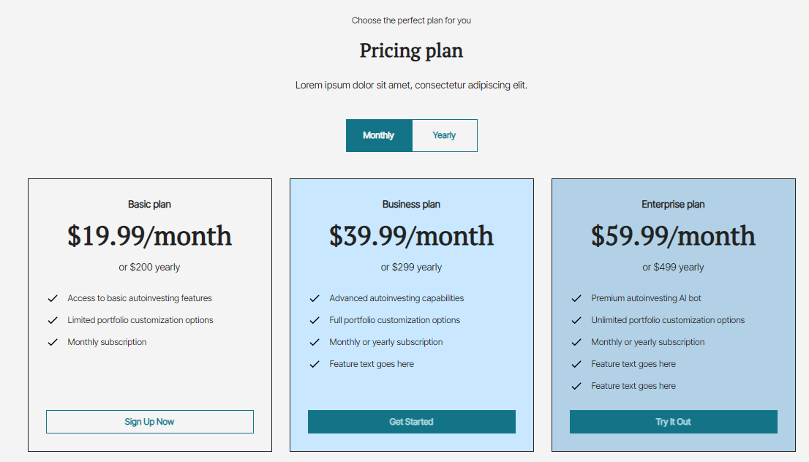
Front end
Notes:
Only guidance
Arrange risk taken
Submit Limit order
Or let the bot decide for them

Slide 9
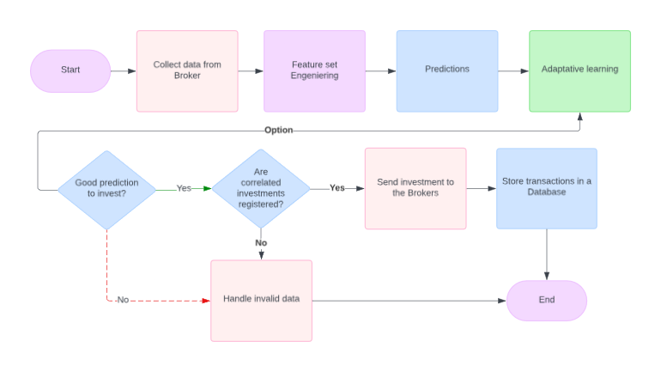
Data flow daily basis

Slide 10

Results observed

Slide 11
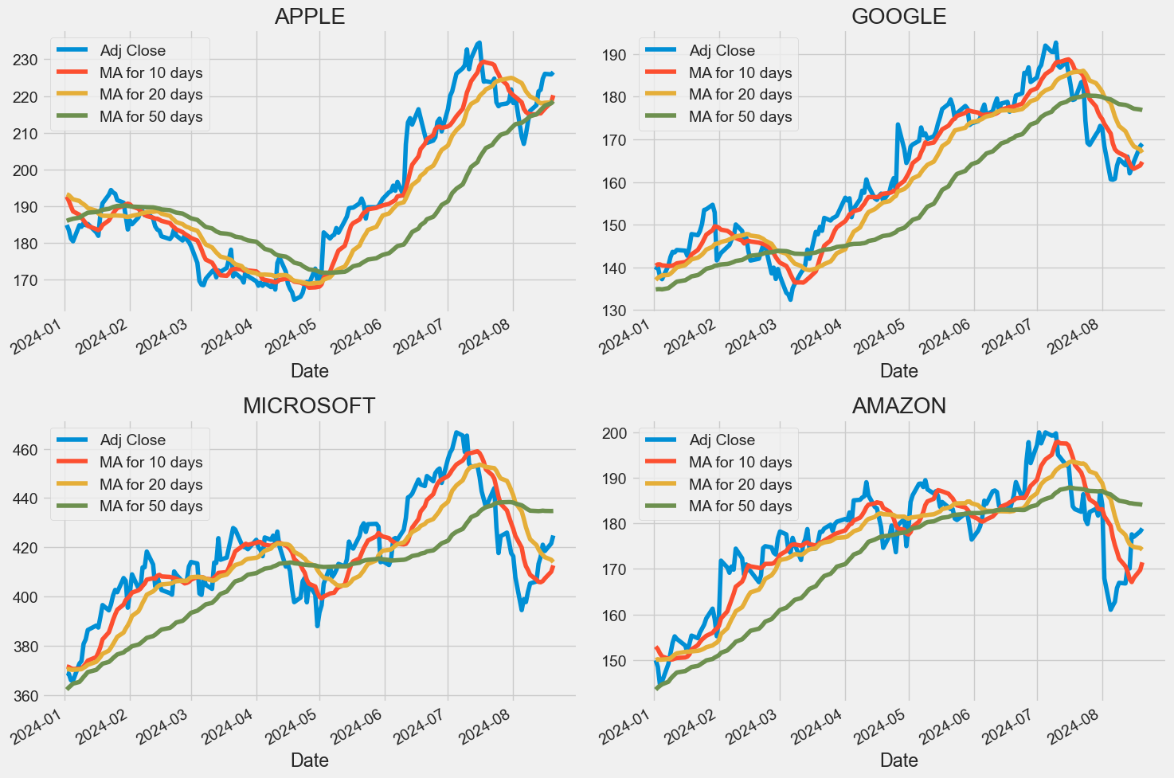
Historical data Moving Average
MA = (Sum of price values for n periods
Notes:
Quantitative analysis
Market behavior

Slide 12
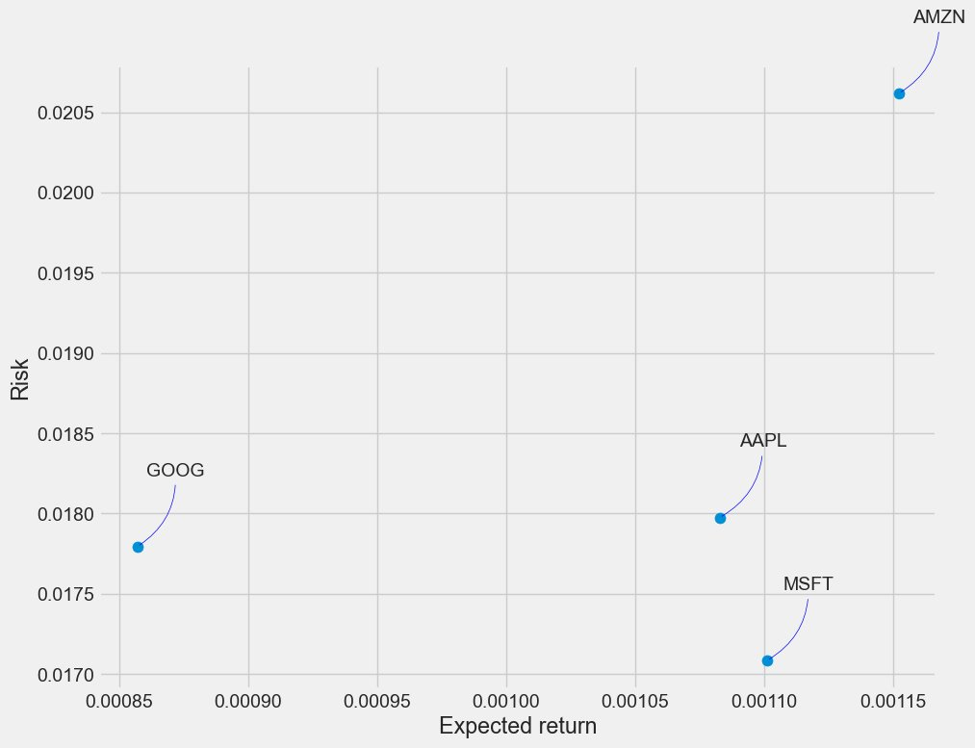
Risk adjusted vs the expected return
I have gathered on daily percentage returns is by comparing the expected return with the standard deviation of the daily returns
Notes:
Quantitative analysis
Market behavior

Slide 13
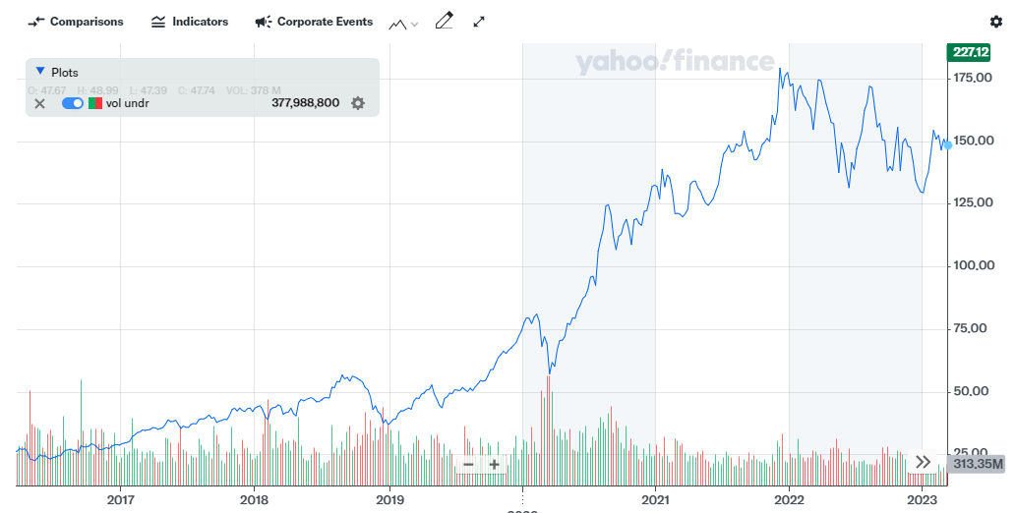
Historical data
APPLE – Yahoo Finances
2016-01-01 2023-12-30

Slide 14
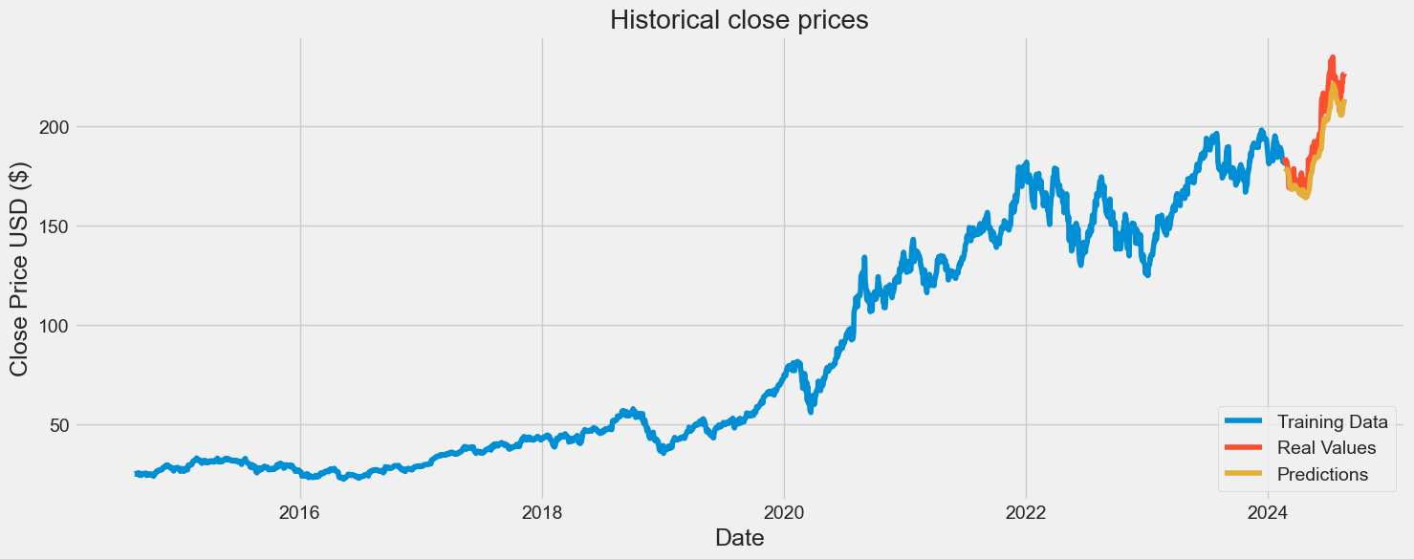
Historical data
APPLE - Closing prices – Yahoo Finances
2014-08-20 2024-08-20
Notes:
.95 of the data is used to train the model

Slide 15
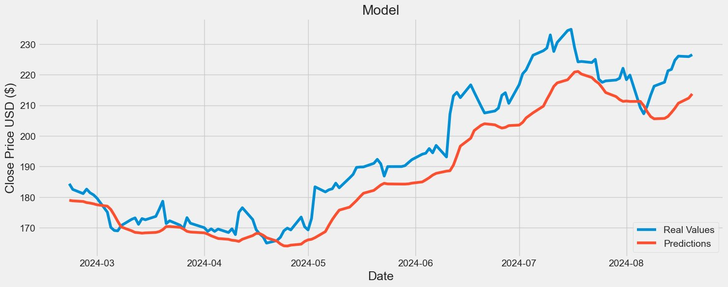
Historical data
APPLE - Closing prices – Yahoo Finances
2014-08-20 2024-08-20
Layer | Output Shape
LSTM | 128 Units
LSTM | 64 Units
Dense | 25
Dense | 1
Mean Squared error (MSE) | 82.95
Root mean Squared error (RMSE) | 9.10
Mean absolute Error (MAE) | 7.46
R2 score | 0.82
Predictions YYYY-MM-DD
2024-02-22 until 2024-08-20

Slide 16
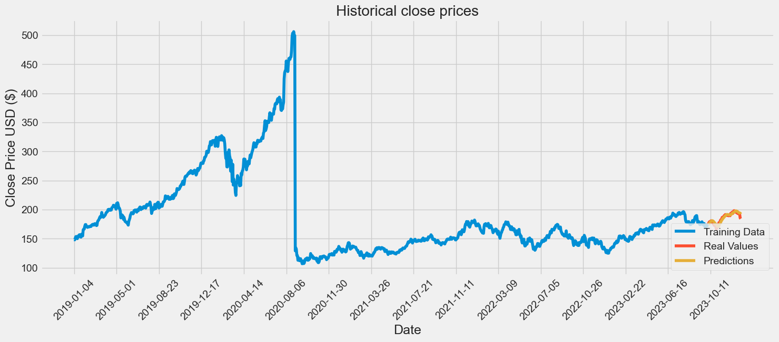
Historical data
APPLE - Closing prices – Alpaca
2016-01-04 2024-01-03
Notes:
mean of the values
standard deviation

Slide 17
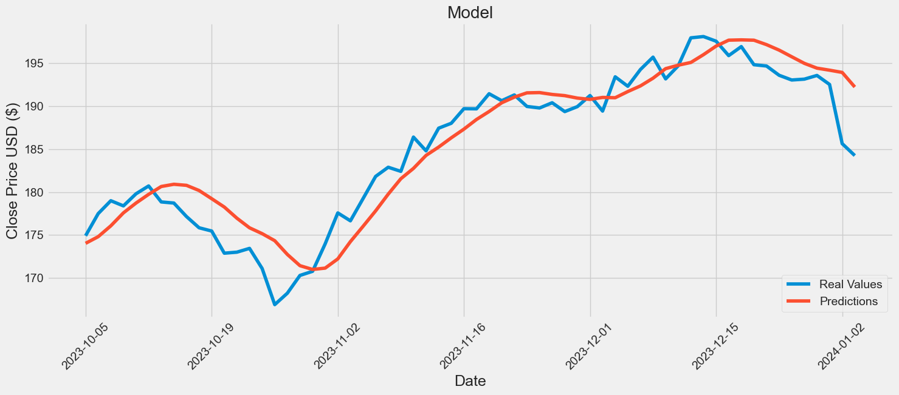
Historical data
APPLE - Closing prices – Alpaca
2016-01-04 2024-01-03
Layer | Output Shape
LSTM | 64 Units
LSTM | 64 Units
Dense | 64
Dense | 1
Mean Squared error (MSE) | 26.85
Root mean Squared error (RMSE) | 5.18
Mean absolute Error (MAE) | 4.35
R2 score | 0.64
Predictions YYYY-MM-DD
2023-10-05 until 2024-01-03
Notes:
mean of the values
standard deviation

Slide 18
Comparing results
Yahoo Finances
2014-08-20 2024-08-20
Alpaca
2016-01-04 2024-01-03
Top
Date | Close | Prediction | Diff | Diff %
22-02-2024 | 184,37 | 178,96 | 5,41 | 2.93
23-02-2024 | 182,52 | 178,79 | 3,73 | 2.04
26-02-2024 | 181,16 | 178,59 | 2,57 | 1.41
27-02-2024 | 182,63 | 178,23 | 4,40 | 2.41
28-02-2024 | 181,42 | 178,06 | 3,36 | 1.84
Date | Close | Prediction | Diff | Diff %
05-10-2023 | 174.91 | 174,03 | 0,88 | 0,50
06-10-2023 | 177.49 | 174,80 | 2,69 | 1,51
09-10-2023 | 178.99 | 176,07 | 2,92 | 1,63
10-10-2023 | 178.39 | 177,58 | 0,81 | 0,46
11-10-2023 | 179.80 | 178,72 | 1,08 | 0,60
Bottom
Date | Close | Prediction | Diff | Diff %
14-08-2024 | 221,72 | 207,64 | 14,08 | 6.35
15-08-2024 | 224,72 | 209,03 | 15,69 | 6.98
16-08-2024 | 226,05 | 210,68 | 15,37 | 6.79
19-08-2024 | 225,89 | 212,34 | 13,55 | 5.99
20-08-2024 | 226,51 | 213,72 | 12,79 | 5.64
Date | Close | Prediction | Diff | Diff %
27-12-2023 | 193,15 | 194,99 | 183,85 | 0,95
28-12-2023 | 193,58 | 194,43 | 0,85 | 0,44
29-12-2023 | 192,53 | 194,19 | 1,66 | 0,86
02-01-2024 | 185,64 | 193,93 | 8,29 | 4,47
03-01-2024 | 184,25 | 192,23 | 7,98 | 4,33
Notes:
mean of the values
standard deviation

Slide 19

What I have learn?

Slide 20
Software engineer
linux in windows, WSL windows subsytems.
Adapt docker images.
Finances
Portfolio managements
Quantitative analysis
Quantitative momentum strategy
Risk management
Machine Learning
Deeper knodledge about neuronal networks
Measure and ensure quality predictions with LSTM
New techniques to control overfitting
Dropout Regularization
Early Stopping
Reduce Model Complexity
Feature engineer
new tactics to analize data
Scaling stock values
controlling risks
Notes:
Dropout Regularization -> delete a portion of the data per layer used
Early stopping -> monitors the model's performance on a validation set during training and stops the training process if the model’s performance stops improving.
Reduce Model Complexity -> fewer layers, data an parameters

Slide 21

Next steps?

Slide 22


MVP - Minimum viable product
Let free will to the bot
machine learning
Implement overfitting techniques.
Optimize the adam optimizer
Back end
Invest depending on the volatility predicted.
Save in BD predictions.
Connect with test Brocker environment.
Daily recursion of predictions and evaluation of new values.
database
Store predictions and the error measurement estimations.
Store Investing movements.
Finances
Easy and secure accumulative strategy.
Manage risks

Slide 23


optimal product
machine learning
Predictions with different time frame (1D, 4H, 1H)
Check quality predictions daily.
Back end
Advanced comparison between volume momentum and different time frame predictions.
Readjustment of investing.
Finances
Adjust quantitative momentum
Rebalancing portfolio management.
Front end
fully connected web page
Implantation of plans

Slide 24


THANK YOU
Matias Aravena
matias.aravena.g@gmail.com
https://github.com/MatAravena

